Slide 1
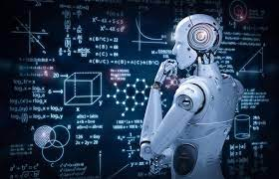
prediction of structure in the atmosphere
UPPALA LIKITHA-20BCI7048
SHARANYA JORRIGALA-20BCI7092

Slide 2

AbSTRACT
The ionosphere is at the horizon of the atmosphere and outer space.
This problem from the Geophysics domain can be mapped into a binary classification problem in Machine learning. We would need to classify the data into good(‘g’) and bad(‘b’). Good (‘g’) radar shows some evidence of returns in the Ionosphere whereas Bad (‘b’) radar are those signals that do not pass through the ionosphere.

Slide 3

OBJECTIVES
In Ionospheric research, we need to classify the signals as useful(good) or useless(bad) .
To compare accuracy scores using different algorithms.

Slide 4
Proposed algorithm
LOGISTIC REGRESSION
SUPPORT VECTOR MACHINE
K-NEAREST NEIGHBOR
RANDOM FOREST
NEURAL NETWORK

Slide 5
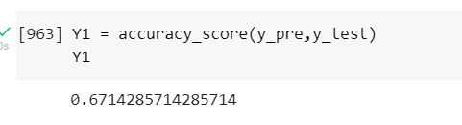
Logistic Regression
Logistic regression is a supervised learning classification algorithm used to predict the probability of target variable. The nature of target or dependent variable is dichotomous, which means there would be only two possible classes. When logistic regression algorithm applied on our dataset it provides an accuracy of 67.2%

Slide 6
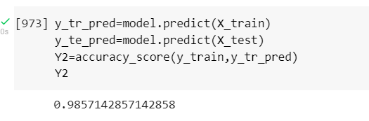
SUPPORT VECTOR MACHINE
Support Vector Machine(SVM) is a supervised machine learning algorithm used for both classification and regression. Though we say regression problems as well its best suited for classification. The objective of SVM algorithm is to find a hyperplane in an N-dimensional space that distinctly classifies the data points. When SVM algorithm applied on our dataset it provides an accuracy of 98.5%

Slide 7
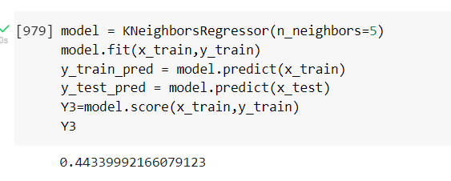
K-NEAREST NEIGHBOR
K-Nearest Neighbor is one of the simplest Machine Learning algorithms based on Supervised Learning technique .KNN algorithm assumes the similarity between the new case/data and available cases and put the new case into the category that is most similar to the available categories. When KNN algorithm applied on our dataset it provides an accuracy of 44.3%

Slide 8
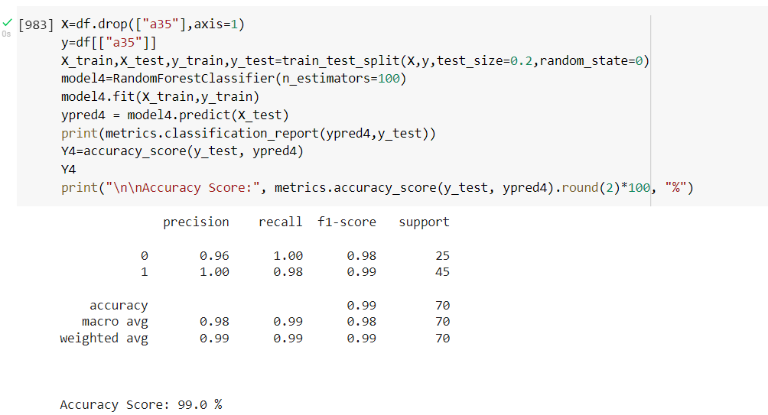
Random Forest
Random Forest is a classifier that contains a number of decision trees on various subsets of the given dataset and takes the average to improve the predictive accuracy of that dataset. For our data, RF provides an accuracy of 99.0%.

Slide 9
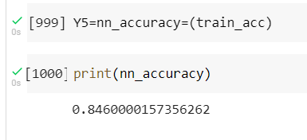
NEURAL NETWORK
A neural network is a series of algorithms that endeavors to recognize underlying relationships in a set of data through a process that mimics the way the human brain operates. In this sense, neural networks refer to systems of neurons, either organic or artificial in nature. When neural network algorithm applied on our dataset it provides an accuracy of 84.6%

Slide 10
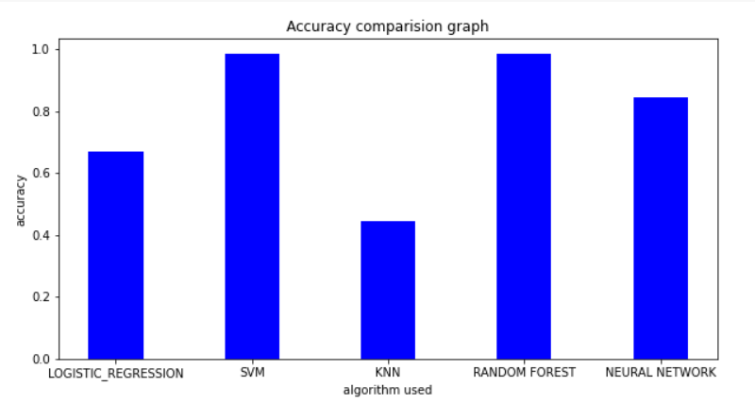
Accuracy comparision graph

Slide 11
RESULTS
So as to perform accurate prediction and stand on the inconsistent trends in atmosphere using various machine learning classifiers like Logistic Regression, SVM,KNN, Random Forest ,Neural network are applied to urge a pattern. By applying the above machine learning classifiers, we came into a conclusion that Random Forest algorithm provides the foremost accurate value.
It is clear that among all the five algorithms, Random forest gives the better accuracy as compared to other algorithms.

Slide 12
CONCLUSION
This project focuses on the prediction of structure in atmosphere using Ionosphere dataset. Several machine learning methodologies used for the calculation of accuracy. Random Forest classifier is best used for the prediction.
Link for Ionosphere Dataset: IONOSPHERE DATASET

